Slide 1

Visa Pitchbook
MGT 587 Business Performance Analysis Group B
Praneeth Malkuchi
Daniel Sergent
Harika Sai Kolanuvada
Chanukya Bolli

Slide 2
Introduction
Today, we are excited to present our comprehensive analysis of Visa Inc., a leading player in the financial services industry, and a comparison with its prominent competitor, Mastercard Inc.
Our comprehensive evaluation delves into both qualitative and quantitative aspects, their competitive advantages, growth prospects, and catalysts for investment opportunities. Our aim is to provide you with valuable insights that will help guide your investment decisions in these two major players of the payment processing industry.

Slide 3
Description of the business
Visa Inc. and Mastercard Inc. are two of the most recognizable names in the financial sector, facilitating transactions for individuals, businesses, and governments across the globe. As the world becomes increasingly digital, their services have become essential in driving the global economy forward.
Visa and Mastercard dominate the global payments landscape, facilitating transactions between consumers, merchants and financial institutions. offering a range of products and services that enable electronic transactions.
Visa, founded in 1958, boasts a robust global network, while Mastercard, established in 1966, has maintained a similar global reach. Both companies have evolved into tech-driven enterprises, leveraging cutting-edge technology to enhance their services.

Slide 4

Industry segment and Oligopolistic structure
The payments industry, marked by its complex network of financial institutions, retailers, and consumers, is a prime example of an oligopolistic market structure. Visa and Mastercard, along with a few other key players, hold sway over this industry due to their massive customer base, extensive merchant partnerships, and established infrastructure.
The payment processing industry exhibits an oligopolistic structure, which is characterized by a handful of large firms that control a significant portion of the market. The high barriers to entry, such as the need for extensive infrastructure and regulatory compliance, create a substantial competitive advantage for these established players.

Slide 5
Competitive advantage
Both Visa and Mastercard benefit from substantial competitive advantages due to their brand recognition, widespread acceptance, and extensive global network. The strong brand identity that they have built over the years provide a high level of trust and reliability to consumers.
One of the paramount factors contributing to Visa and Mastercard's competitive advantage is the formidable network effect they've fostered over the years.
Their vast networks of merchants and cardholders amplify the value proposition for all parties involved. Furthermore, the high costs associated with building a similar global infrastructure serve as a significant drawback for entrants. This competitive channel shields them from immediate threats and strengthens their competitive position.

Slide 6
Growth and Catalyst Investment opportunities
Both Visa and Mastercard are positioned to harness several growth opportunities in the rapidly evolving payments landscape. The shift towards cashless transactions, e-commerce and the adoption of mobile payments represent avenues for sustained growth.
The catalytic factors driving investment opportunities in Visa and Mastercard are much higher than others in the industry. The ongoing trend towards a cashless society stands as a foundational catalyst. Their innovation in areas such as biometric authentication, and blockchain integration further solidifies their relevance. Lastly, the potential for partnerships with fintech disruptors could amplify growth by expanding their service offerings and customer reach.

Slide 7
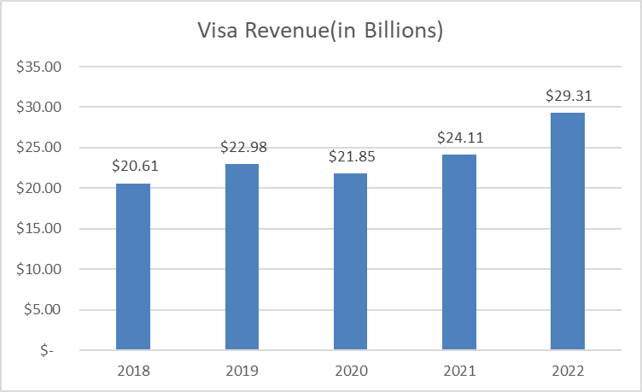
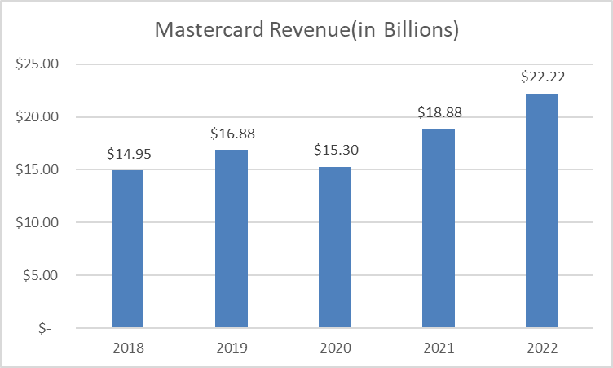
Revenue

Slide 8
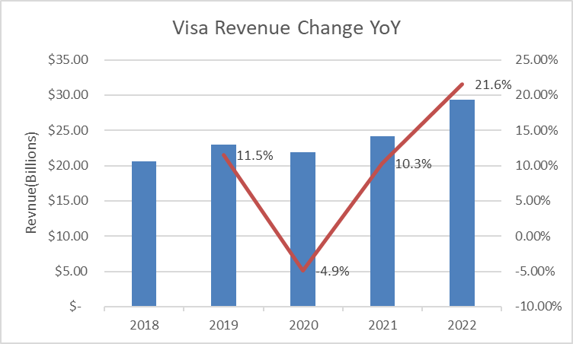
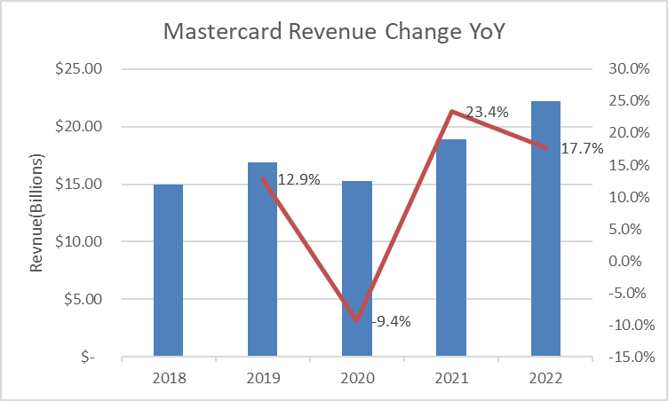
Revenue Growth
Revenue decreased in 2020 due to the pandemic, but quickly bounced back in 2021 as quarantine became less strict and people began spending more again. Revenue is expected to continue growing as global credit-card spending increases.

Slide 9
Financials Notes
Visa spends a significantly lower amount of their net revenue on operating expenses. Over the past 3 years, Visa has spent on average 26.45% of their net revenue on operating expenses while Mastercard has spent on average 34.66%. Consequently, Visa retains a higher amount of their net revenue in comparison to Mastercard. Over the past 3 years, Visa's net income has averaged 50.61% of their net revenue while Mastercard has averaged 44.19%.

Slide 10
Liquidity Ratios
Visa |  |  | Measure | Mastercard
2022 | 2021 | 2020 |  | 2022 | 2021 | 2020
1.45 | 1.75 | 1.91 | Current ratio | 1.17 | 1.29 | 1.61
1.15 | 1.47 | 1.64 | Quick ratio | 0.88 | 0.97 | 1.26
Current ratio –Visa’s ratio deteriorated over the years however it had a strong ratio above 1 throughout the period, meaning it has no difficulty in paying off current liabilities whereas Mastercard, on the other hand maintained the ratio above 1 but can improve further for better performance.
Quick ratio – Visa’s quick ratio is above 1 from 2020-2022 and showed a decreasing trend. Mastercard initially had strong ratio but dropped below 1 during last two years which indicates that the company is heavily dependent on inventory that can take time to liquidate.

Slide 11
Leverage Ratios
Visa |  |  | Measure | Mastercard
2022 | 2021 | 2020 |  | 2022 | 2021 | 2020
0.63 | 0.56 | 0.66 | Debt / Equity Ratio | 2.23 | 1.9 | 1.98
1.15 | 1.21 | 1.6 | Debt / EBITDA Ratio | 1.08 | 1.21 | 1.45
1.26 | 1.44 | 2.48 | Debt / FCF Ratio | 1.39 | 1.61 | 1.94
Debt Equity ratio –Visa had a low risk as it is below 1 indicating good ratio whereas Mastercard showed a strong ratio close to almost 2 meaning it leverages debt more than equity to finance its operations.
Debt EBITDA ratio – In case of Visa & Mastercard, Debt/EBITDA ratio is above 1 indicates a normal financial condition as low number is preferred by analysts. Both have good debt repayment capabilities.
Debt FCF ratio – Both the companies can pay off their debt with the free cash flow as we see positive ratios.

Slide 12
Profitability Ratios
Visa |  |  | Measure | Mastercard
2022 | 2021 | 2020 |  | 2022 | 2021 | 2020
41.80% | 32.70% | 30.70% | Return on Equity (ROE) | 153.60% | 129.70% | 106.60%
17.90% | 15.10% | 14.20% | Return on Assets (ROA) | 26.50% | 24.30% | 20.00%
76.60% | 69.90% | 60.50% | Return on Capital (ROIC) | 63.20% | 59.50% | 49.90%
Return on Assets – Mastercard and Visa are deploying the assets effectively to generate sales and profits with the strong ROA ratios.
Return on Equity – The companies have strong ROE ratios indicating that they can generate cash and not have to depend on the debt.
Return on Capital – The ratios are desirable as they are more than the desirable range of 15-20%.

Slide 13
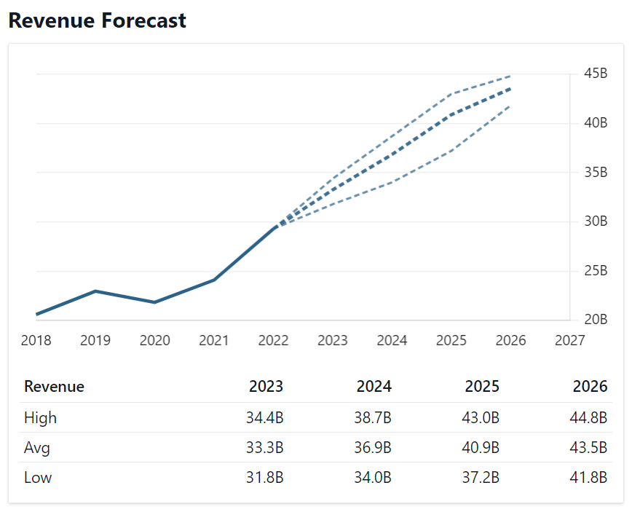
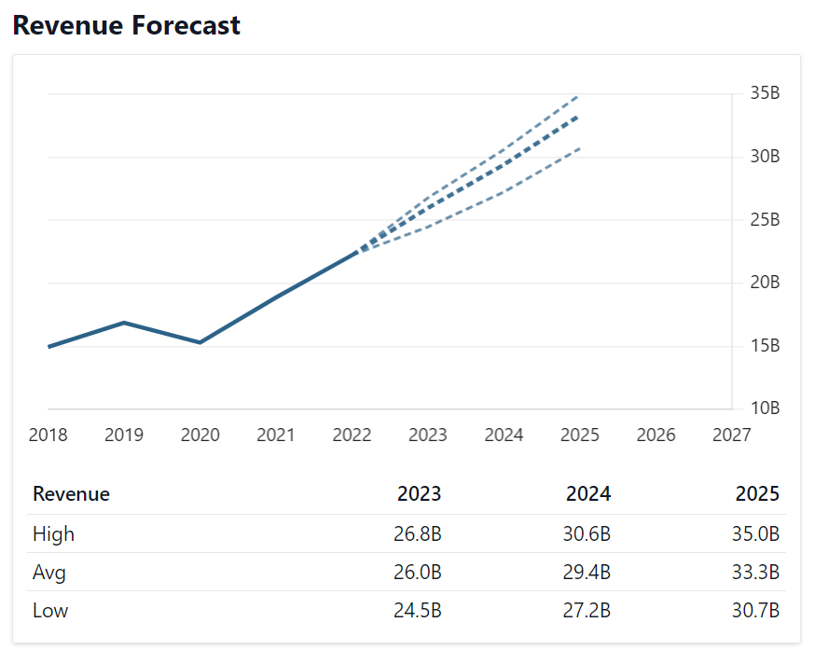
Industry Specific Metrics
VISA
Mastercard
Revenue - In the year 2022, Mastercard had annual revenue of $22.24B and a growth rate of 17.76% while Visa had annual revenue of $29.31B with 21.59% growth. The main source of revenue for both the companies is through processing card transactions.

Slide 14
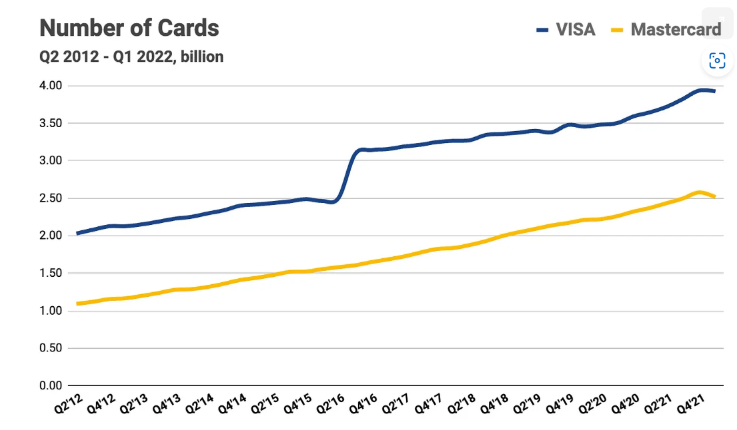
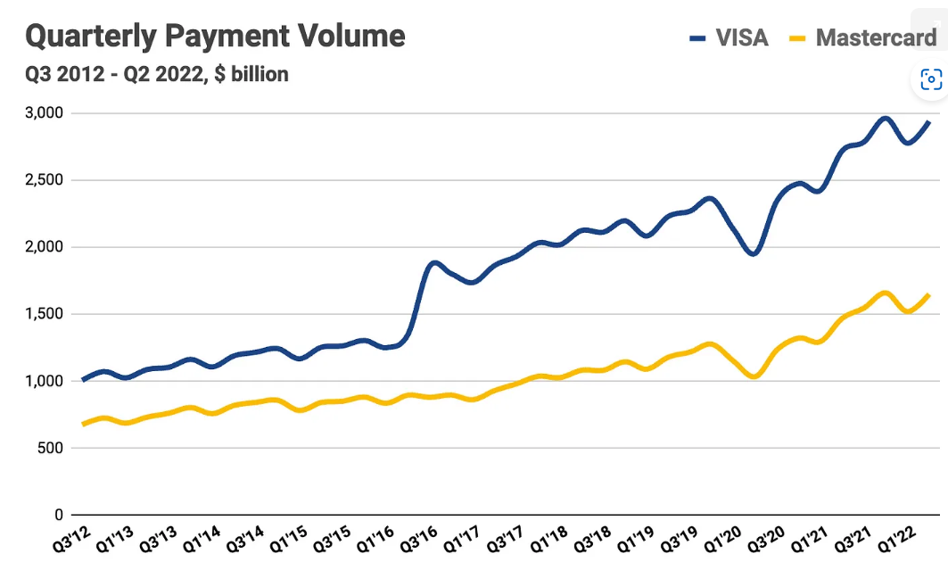
Industry Specific Metrics
Market Share – Visa and Mastercard account for 64% of the global consumer financing market. Between the two, Visa holds higher market share than Mastercard. The number of transactions they process annually is a crucial metric that must be analyzed.
Growth Potential – Both companies have focused on improving growth in their emerging markets.
Strong Past dividend history.

Slide 15
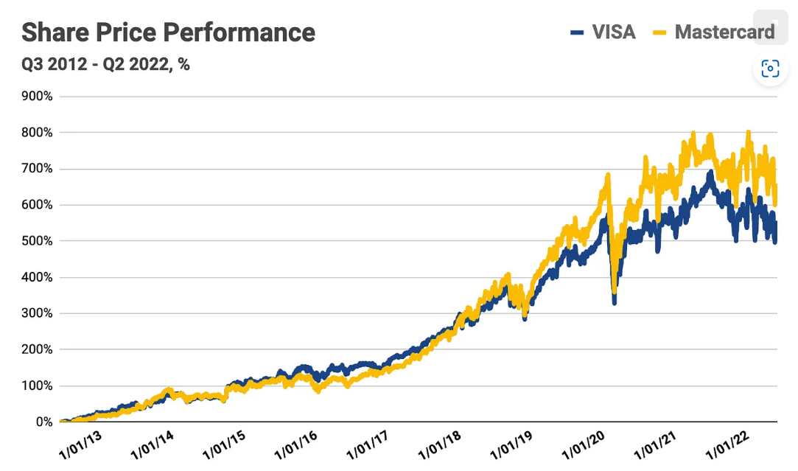
Industry Specific Metrics
VISA’s share price advanced 530%, while Mastercard’s share price advanced 633% over the Q3 2012 - Q2 2022 period (July 2, 2012 - June 29, 2022).
At their respective peaks, VISA’s share price was up 692%, while Mastercard’s share price was up 801%.

Slide 16
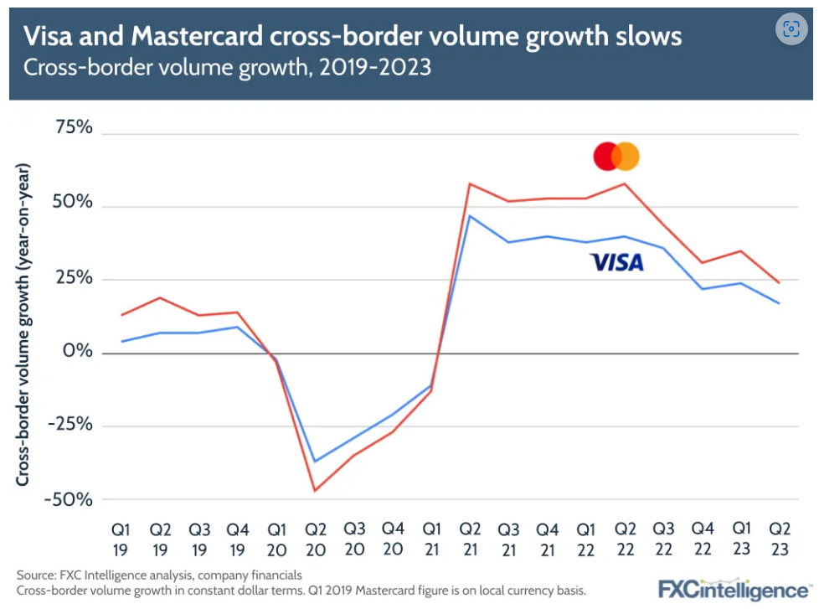
Global Dollar Volume & Cross-border transactions
Mastercard & Visa are two dominant payment processing networks in the electronic payments industry.
Cross border volumes made a major contribution towards revenue growth.
Slow rate of growth in the current year due to covid travel boom in the past.

Slide 17
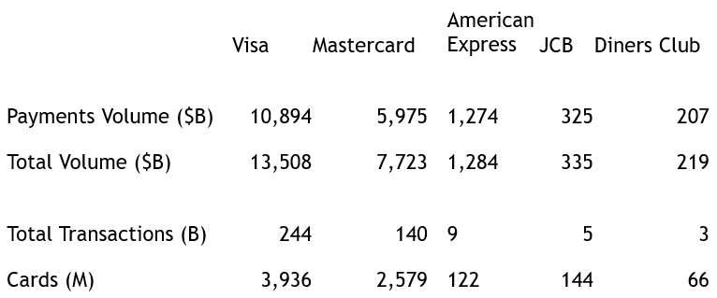
Global Dollar volume & Cross border Payments
 | Visa | Mastercard
Cross Border Volume ($B) | 9,815 | 6,597
Cross Border Volume growth | 40% | 45%
Cards (B) | 3.5 | 2.89
Mastercard’s gross dollar volume (GDV) for the fourth quarter of 2022 likely climbed 4.7% to $8.2 trillion1.
According to Visa’s year-end financial highlights for fiscal year 2022, their total volume, including payments and cash volume was $14.1T1.

Slide 18
Other Relevant Items
Visa
Suspended operations in Russia since March 2022 due to economic sanctions.
Acquisition of The Currency Cloud Group Limited (Currencycloud) in December 2021 & Tink in March 2022.
Exposed to risks from foreign currency exchange rate fluctuations related to translation as the functional currency of Visa Europe is the Euro.
Mastercard
Loss of revenue of 4% Suspension of operations in Russia and Ukraine due to government sanctions.
Dollar Euro currency fluctuations imposing foreign exchange risk.
Acquisition of Dynamic Yield LTD in April 2022, Nets Denmark A/S, Ekata etc.

Slide 19
Valuation Metrics
Metric | Visa Inc | Mastercard Inc
EPS | $7 | $10.22
P/E Ratio | 25.38 | 34.02
Forward P/E Ratio | 24.04 | 32.26
Earnings per share(EPS):
Visa has an EPS of $7, while Mastercard has an EPS of $10.22. Mastercard having a higher earnings per share as compared to Visa, suggests that it is more profitable and efficient in generating earnings for its shareholders.
Price-to-Earnings(P/E) Ratio:
Typically, a favorable Price-to-Earnings (P/E) ratio is below the average P/E ratio, which ranges from 20 to 25. Mastercard's elevated P/E ratio might stem from expectations of robust future earnings growth in contrast to Visa. However, this could also be linked to a perceived higher investment risk with Mastercard, thus indicating a relatively lower investment risk with Visa. Notably, both companies exhibit slightly diminished forward P/E ratios, implying anticipated earnings growth in the future.

Slide 20
Metric | Visa (Mega cap) | Mastercard (Mega cap)
Dividend Yield​ | 0.7%​ | 0.6%​
Market Cap​ | $377.45 B (as of 9/30/2022)​ | $334.33 B (as of 30/12/2022)​
Stock Price​ | $177.65 (as of 9/30/2022)​ | $347.73 (as of 30/12/2022)​
Dividend Yield:
The dividend yields of Visa and Mastercard are 0.7% and 0.6% respectively. The low dividend yields of both companies indicate that they prioritize reinvesting profits into the business rather than distributing them as dividends.
Market Capitalization:
Both Visa and Mastercard are classified as mega-cap companies, boasting market capitalizations surpassing $200 billion. Visa's market capitalization is higher at $377.45 billion compared to Mastercard's $334.33 billion, indicating that Visa holds a greater total market value.
Stock Price:
Mastercard has higher stock price than Visa, which combined with its higher P/E ratio, indicates that investors are valuing Mastercard more highly per share as compared to Visa.

Slide 21
Metric | Visa | Mastercard
PEG ratio​ | 0.21​ | 0.30​
EV/EBITDA​ | 73.62 (as of 9/30/2022)​ | 100.24 (as of 30/12/2022)​
PEG Ratio:
Both companies have PEG ratios below 1, which indicates that investors might perceive their stocks as being priced at a favorable level relative to their growth potential. Visa's slightly lower PEG ratio of 0.21 might imply that its earnings growth is considered relatively better value compared to Mastercard's growth expectations, which has a PEG ratio of 0.30.
Enterprise Value(EV)/EBITDA:
Visa has a better(lower) EV/EBITDA ratio of 73.62 as compared to Mastercard's EV/EBITDA ratio of 100.24. A lower EV/EBITDA ratio generally suggests that a company's valuation is relatively more appealing, indicating that investors are allocating fewer funds for each unit of EBITDA. Therefore, based on the EV/EBITDA metric, Visa appears to hold a relatively more favorable valuation in comparison to Mastercard.

Slide 22
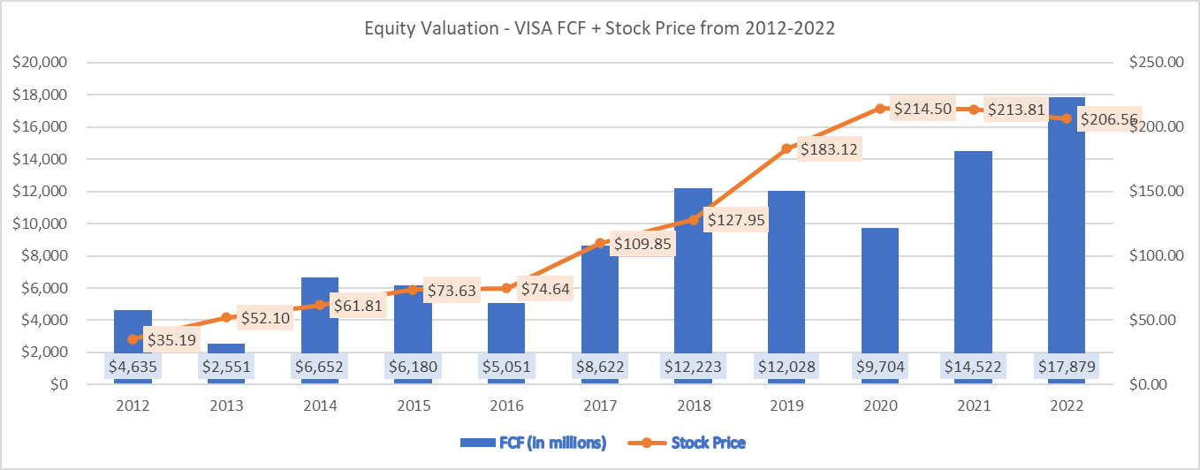

Slide 23
Discounted Cash Flow Analysis for VISA INC.
(Note: The projected cash flows are measured by assuming that the growth rate for the next 3-year period is around 16.5%, while the FCF of Visa is $17.89 B in 2022.This data is taken from macrotrends.net)
2023 Projected Cash Flows = $20,829,035,000
2024 Projected Cash Flows = $24,265,825,775
2025 Projected Cash Flows = $28,269,687,028
Cash flow Growth rate after 2025(g) = 2.5%
Weighted Average Cost of Capital (WACC - discount rate(r)) = 9.50%
Number of shares outstanding = $1890 million
Total Debt Outstanding = $22450 million
Step-1) Present Value(PV) of individual cash flows
PV2023 = 20,829,035,000/(1+0.095)⁰ = $20,829,035,000
PV2024 = 24,265,825,775/(1+0.095)¹ = $22,160,571,484
PV2025 = 28,269,687,028/(1+0.095)² = $23,557,229,021

Slide 24
Step-2) Present Value(PV) of perpetuity beyond 2025
PV2025
= CF2026/(r-g)
= (28,269,687,028 * 1.025)/(0.095 - 0.025) = $413,948,988,624
PV2023
= $413,948,988,624/(1+0.095)² = $345,237,996,392
Step-3) Adding the present values(PVs) for obtaining the Enterprise Value
$20,829,035,000 +
$22,160,571,484 +
$23,557,229,021 +
$345,237,996,392 +
$411,784,831,897 = Enterprise Value
Step-4) Solve for Equity Value
Equity
= Enterprise Value – Debt
= $411,784,831,897 - $22,450,000,000
= $389,334,831,897

Slide 25
Step-5) Solve for per share value
Equity = $389,334,831,897 ; Number of shares = 1,890,000,000
Per share value
= Equity/Number of shares
= 389,334,831,897/1,890,000,000
= $205.997
The per-share value obtained from the Discounted cash flow analysis for Visa Inc. is approximately $206 .This valuation suggests that, at the given assumptions and projected cash flows, each share of Visa Inc. Is estimated to be around $205.99. Whereas, the closing stock price of Visa on Sep 30th,2022 is $177.65. Since, the calculated per-share value is higher than the closing stock price on Sep 30th,2022, it suggests that the stock price is undervalued and there is a potential investment opportunity.

Slide 26
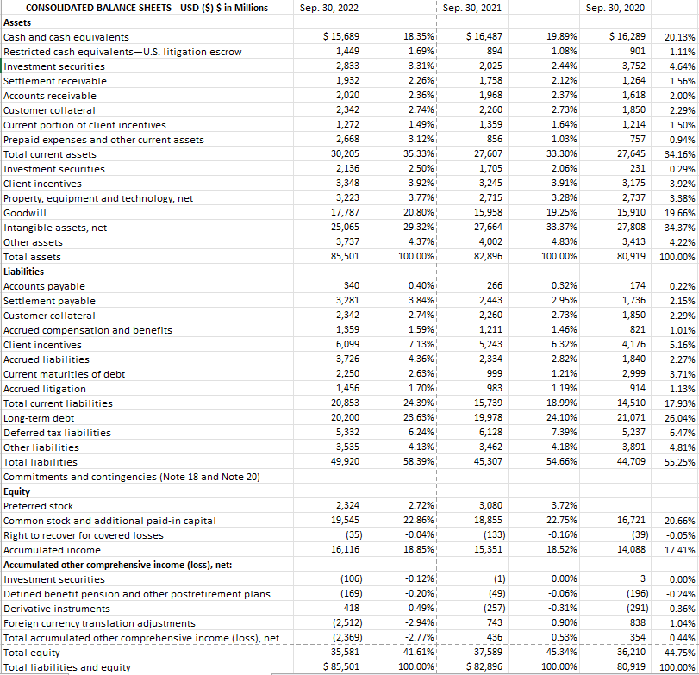
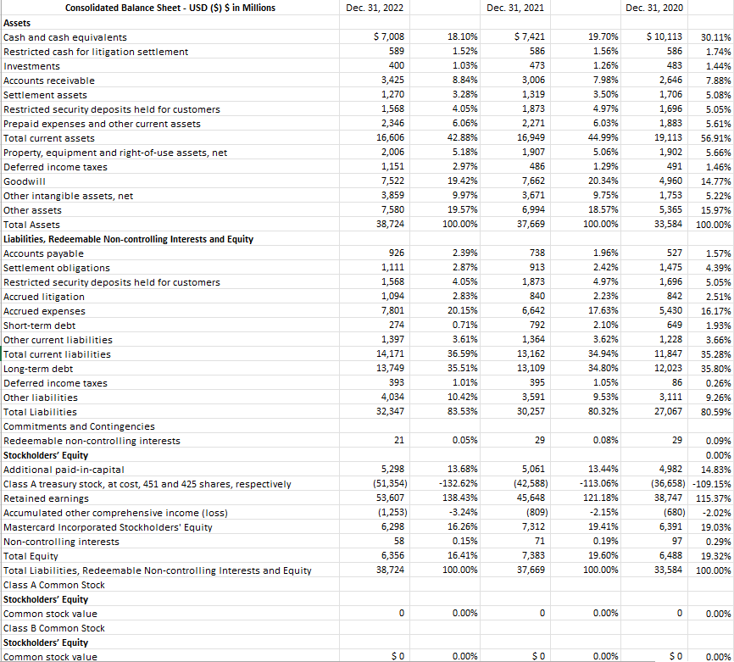
Common-size Balance Sheet
Visa Mastercard

Slide 27
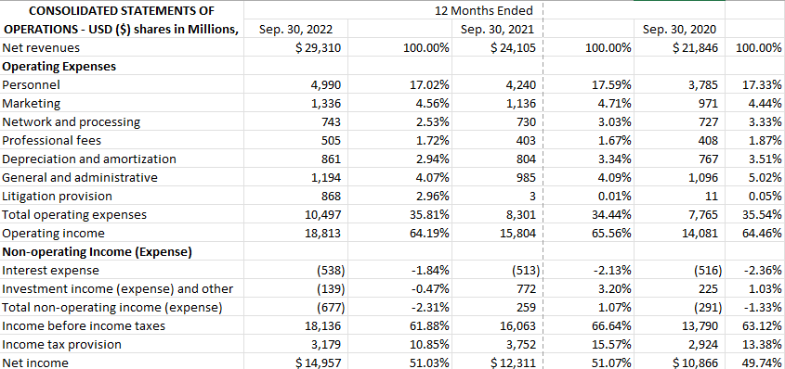
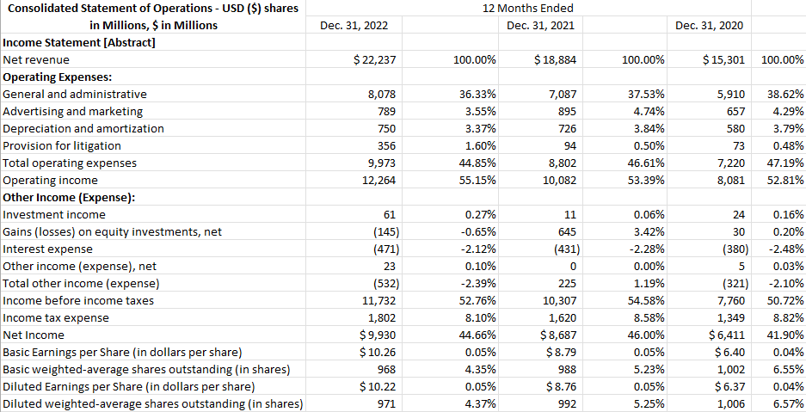
Common-size Income Statement
VISA MASTERCARD

Slide 28
Sources
Visa's 10-k
https://www.sec.gov/edgar/browse/?CIK=1403161&owner=exclude
Mastercard's 10-k
https://www.sec.gov/edgar/browse/?CIK=1141391&owner=exclude
Other References
https://finance.yahoo.com/quote/V/cash-flow?p=V
https://www.macrotrends.net/stocks/charts/V/visa/free-cash-flow
https://www.sec.gov/edgar/browse/?CIK=1403161&owner=exclude
https://finance.yahoo.com/quote/V/cash-flow?p=V
EDGAR Entity Landing Page (sec.gov)
Mastercard Vs. Visa: More Growth Ahead (NYSE:V) | Seeking Alpha
VISA vs. Mastercard: visualizing the might of the payment giants (popularfintech.com)
Visa vs. Mastercard, Here’s What Investors Need To Know About These Two Credit Card Giants (forbes.com)
Cross-border growth slows for Visa and Mastercard in Q2 23 (fxcintel.com)

